Slide 1

.
INTRODUCTION
TO
By
Priyakshi Gupta
Sr Academic Consultant, CIET, NCERT

Slide 2
Goals
To understand the importance and use of language tools
To create interactive and
user-friendly content on
Wordwall
To make learning more
engaging and fun.
To integrate different tools to improve the teaching learning process for languages.

Slide 3
ICT and Language Tools
For Teachers:
Enhances their classroom delivery
Makes teaching-learning fun
Helps in structuring their resources
Provides variety in teaching
For Students:
Makes them proficient in languages and become lifelong learners
Develops their LSRW skills
Enhances their critical thinking skills

Slide 4
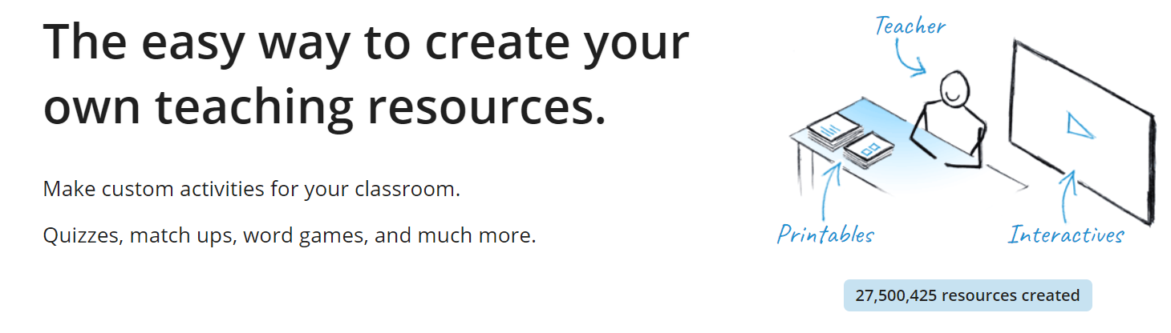
What is Wordwall?
It is an online tool used to create interactive games for students.
It is also used to create printed materials in the form of worksheets.
Its variety of templates are useful in creating and sharing resources from any corner of the world.
It aims to make teachers’ lives easier and to improve the education standard of the students.

Slide 5
Pedagogical Implications of Wordwall on Different Subjects
Wordwall can be used to create content for other subjects as well, which include Mathematics, Science, Social Science etc. apart from languages.
The tool enables students to apply their critical thinking skills, problem solving skills, decoding, enhances their vocabulary and inquiry based learning.
It can be used to improve the overall quality of teaching.
It integrates learning with fun with the help of visual representation.
It enables the teachers to achieve their learning outcomes effectively.

Slide 6
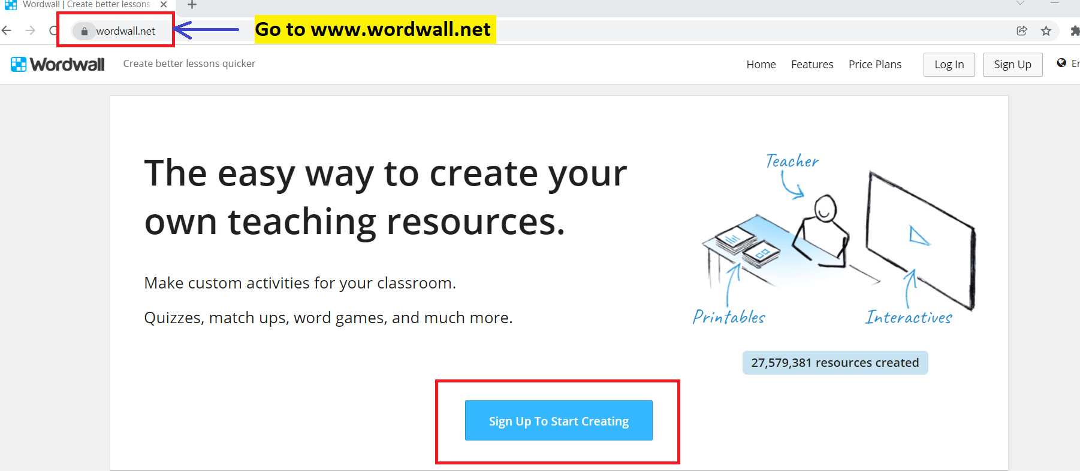
Getting Started

Slide 7
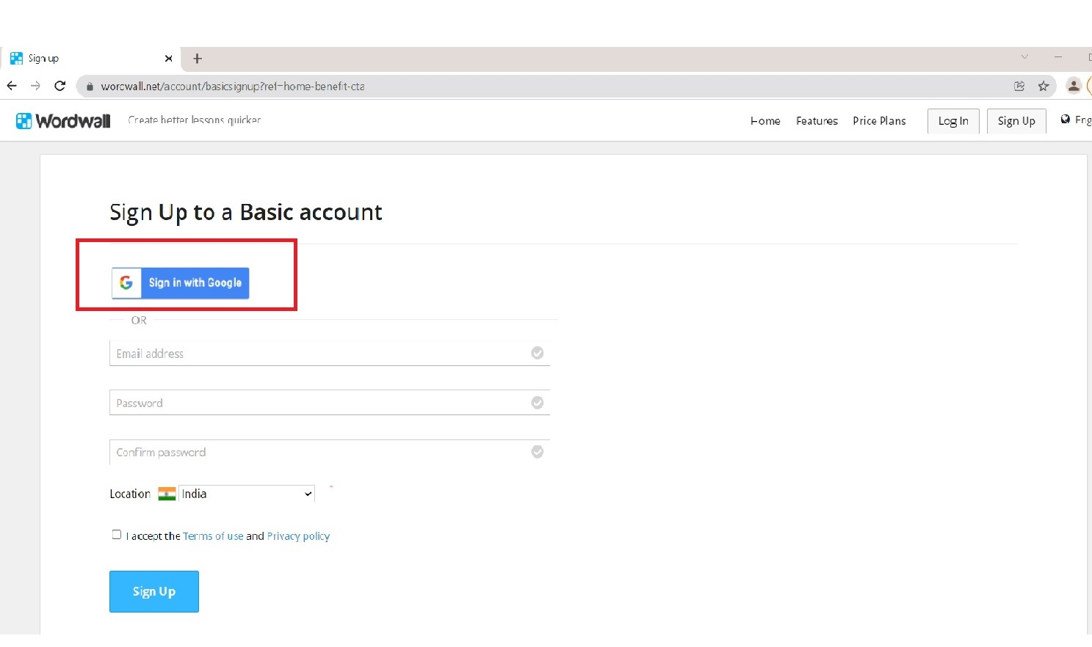
Sign in with Google

Slide 8
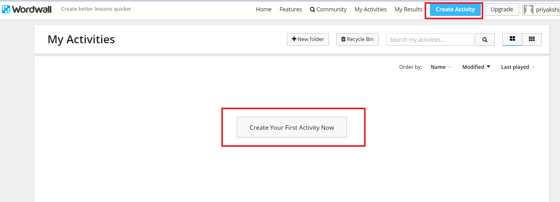
Now that you are all set, click on ‘Create Activity’

Slide 9
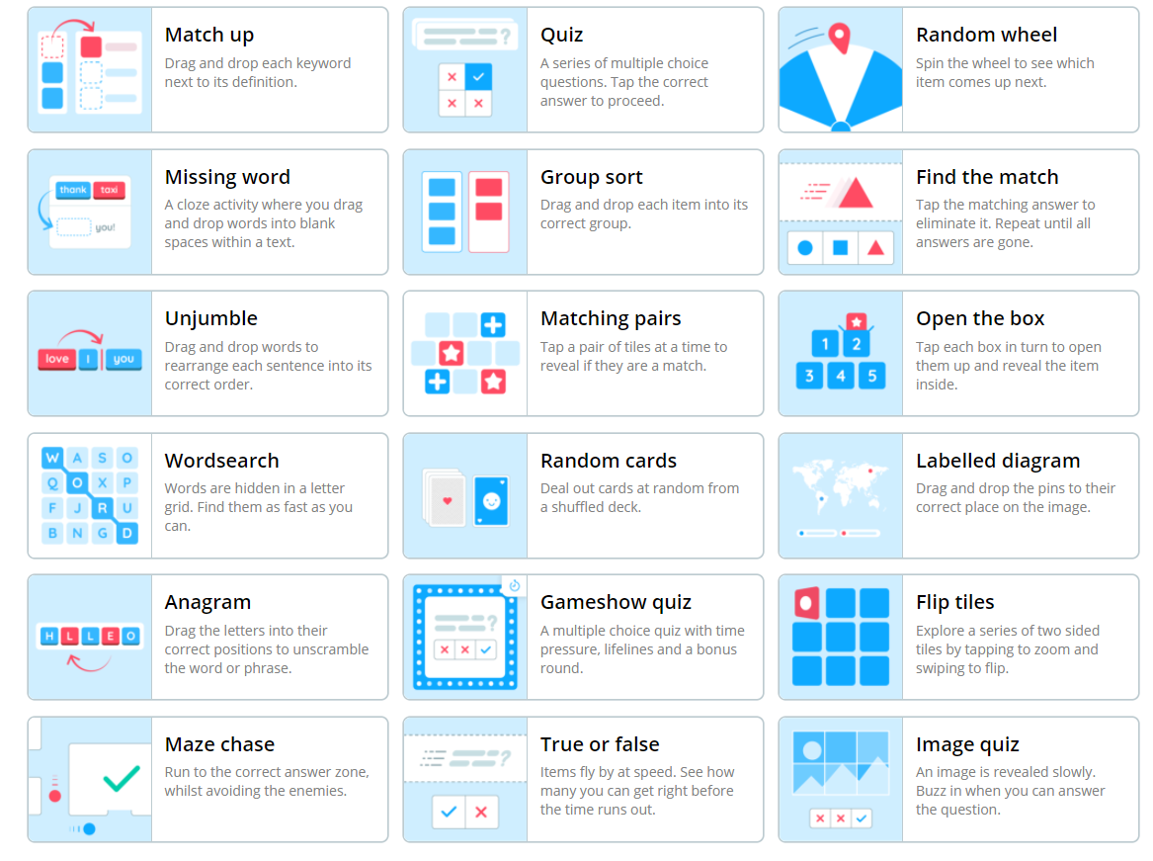
Types of Resources

Slide 10
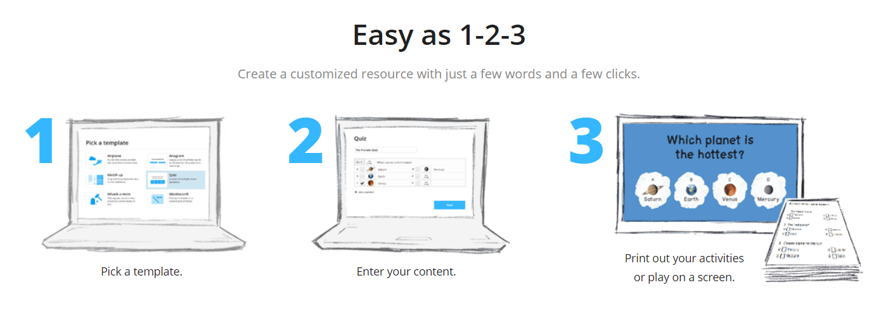
Steps to Create a Resource

Slide 11
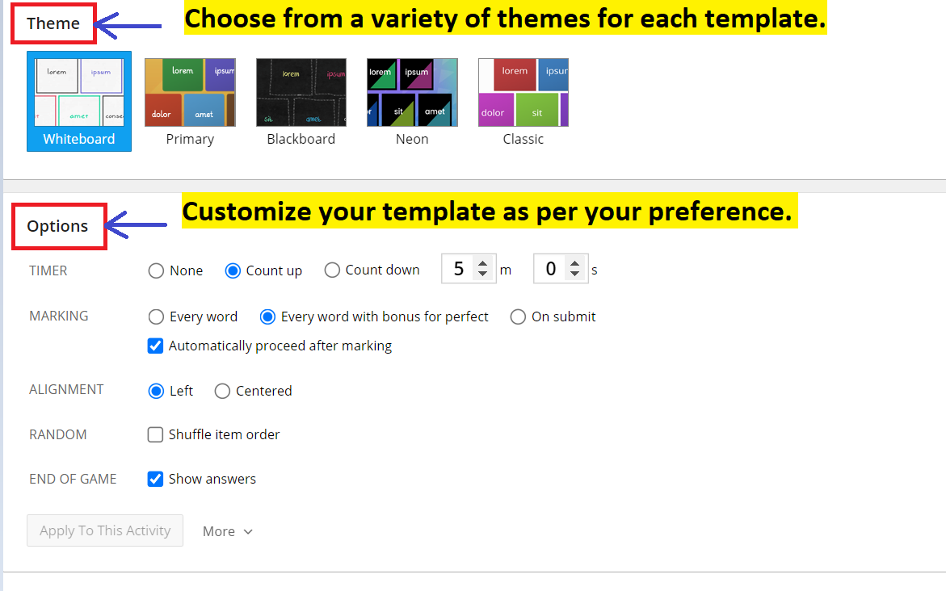
Customize your template

Slide 12
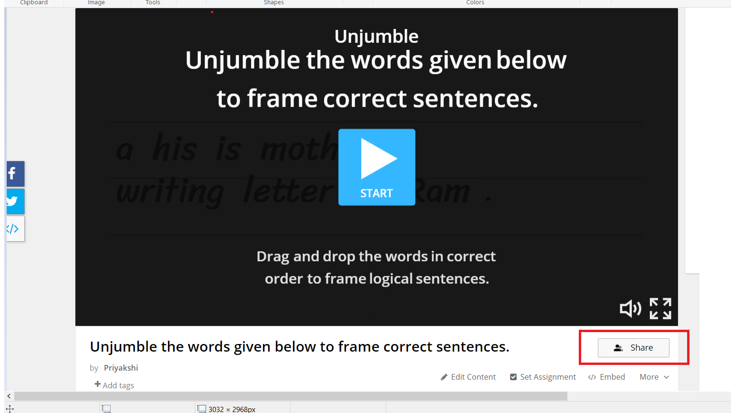
Sharing the Resource with the Students

Slide 13
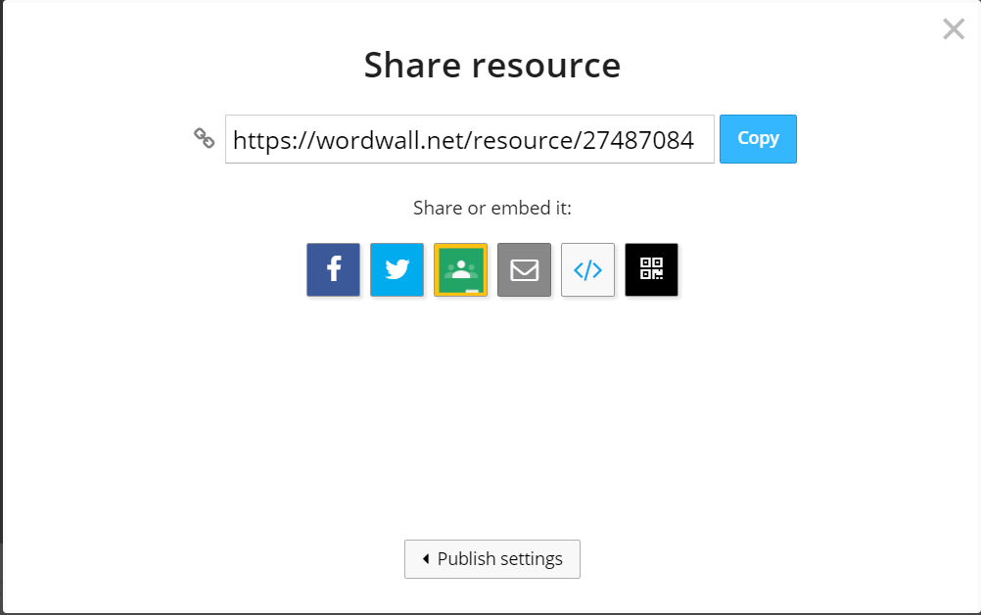
Copy the link or embed it via social media

Slide 14
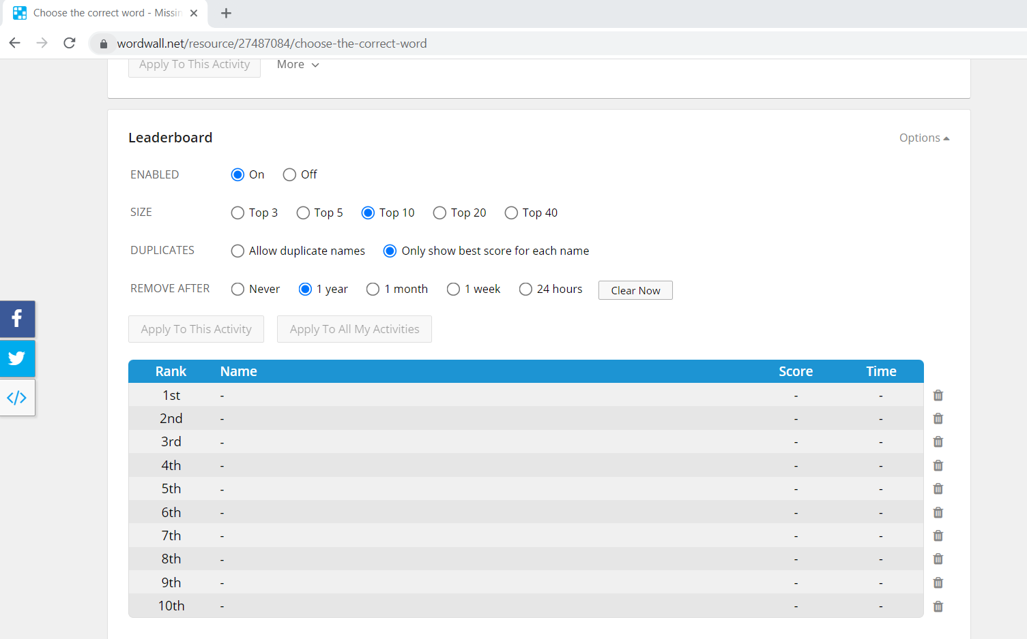
Leaderboard

Slide 15
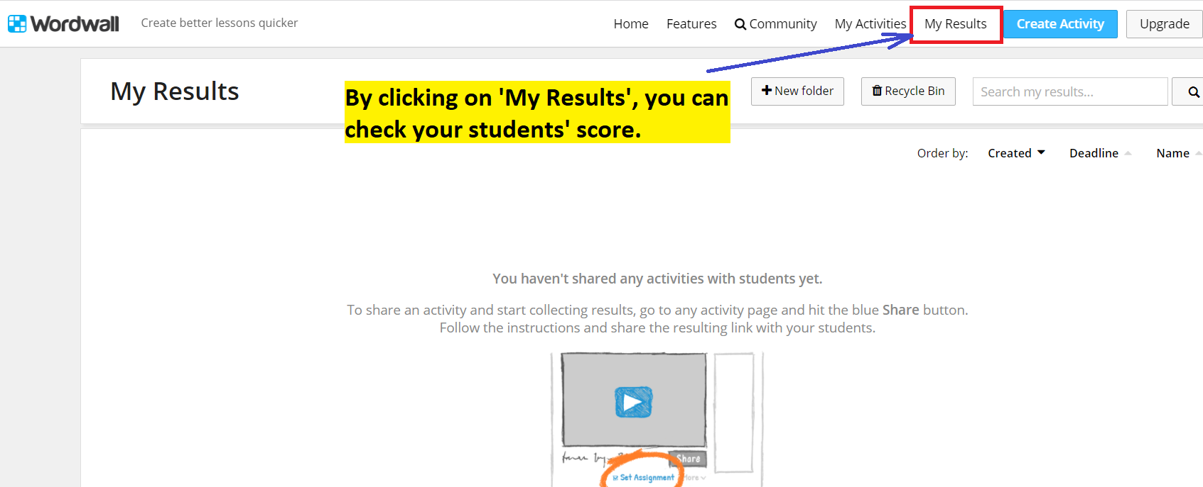
Track your students’ scores
s

Slide 16
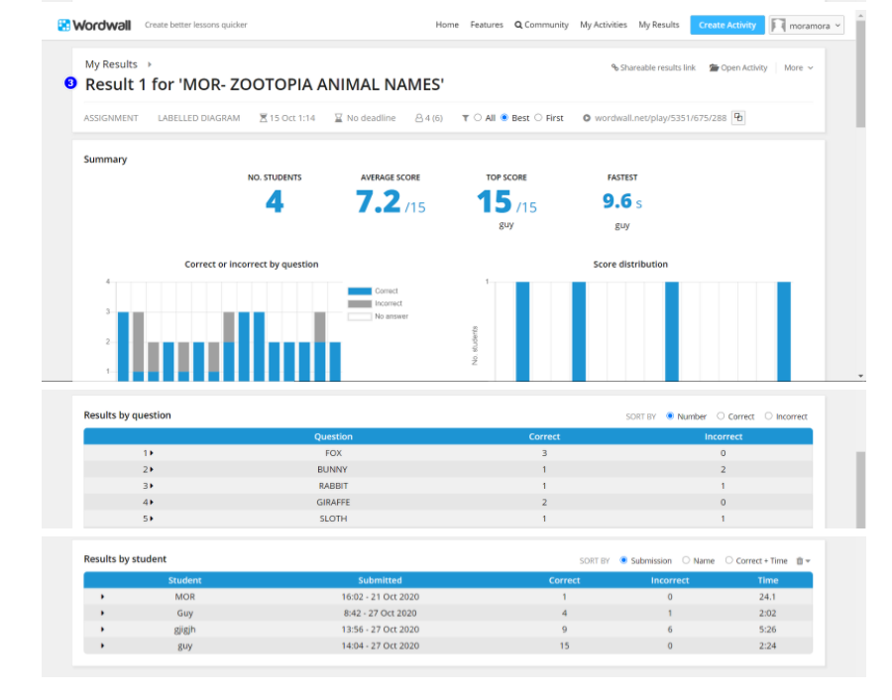
Data of Result

Slide 17
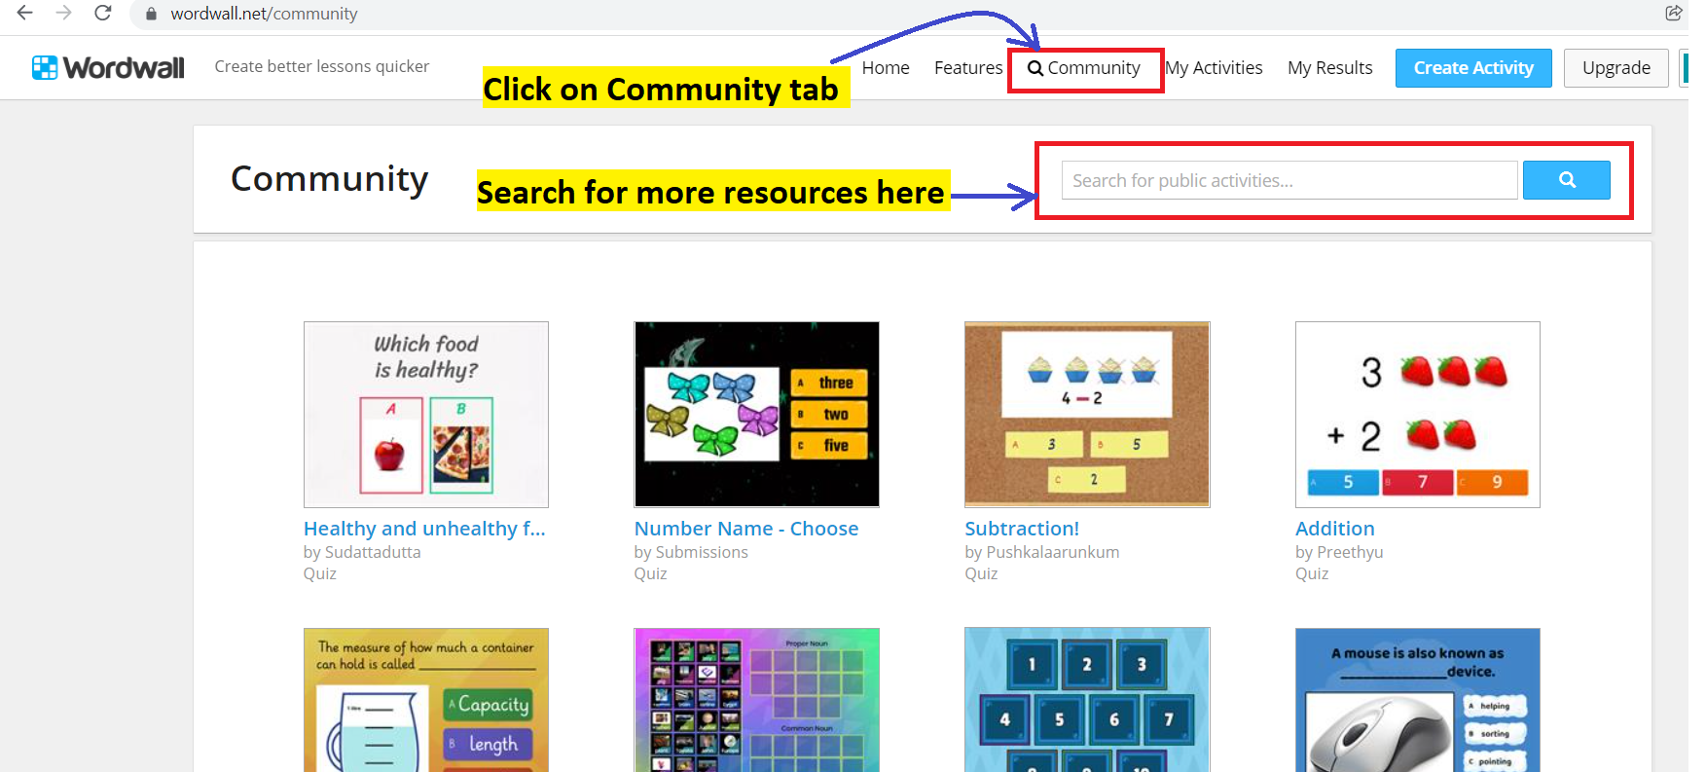
Choose from public resources using the community tab

Slide 18
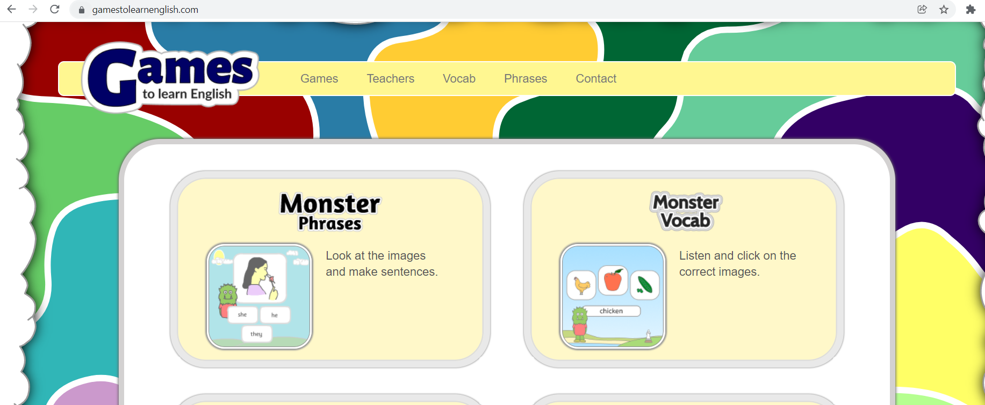
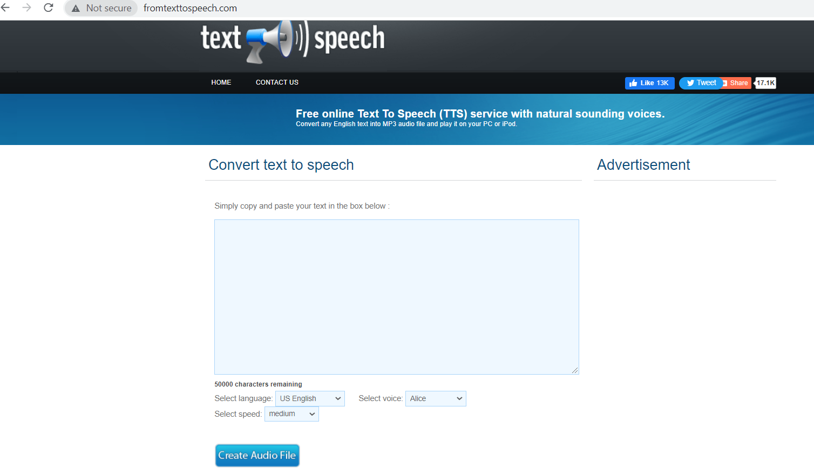
Other Tools for Language Learning
1. www.gamestolearnenglish.com
2. www.fromtexttospeech.com

Slide 19

e-Pathshala: A Treasure Trove of eContent
https://epathshala.nic.in/index.php?ln=en

Slide 20
Resources
1. https://wordwall.net/
2. www.gamestolearnenglish.com
3. www.fromtexttospeech.com
4. https://epathshala.nic.in/index.php?ln=en

Slide 21
THANK YOU

